Slide 1
CS 295A/395D: Artificial Intelligence
Bayes Nets as Causal Graphs
Prof. Emma Tosch
21 March 2022

Slide 2
Agenda
Reminder: student hours today until Noon (Innovation E456)
Recap: Bayes Nets & Independence
New: Bayes Nets as Causal Graphs
New:

Slide 3
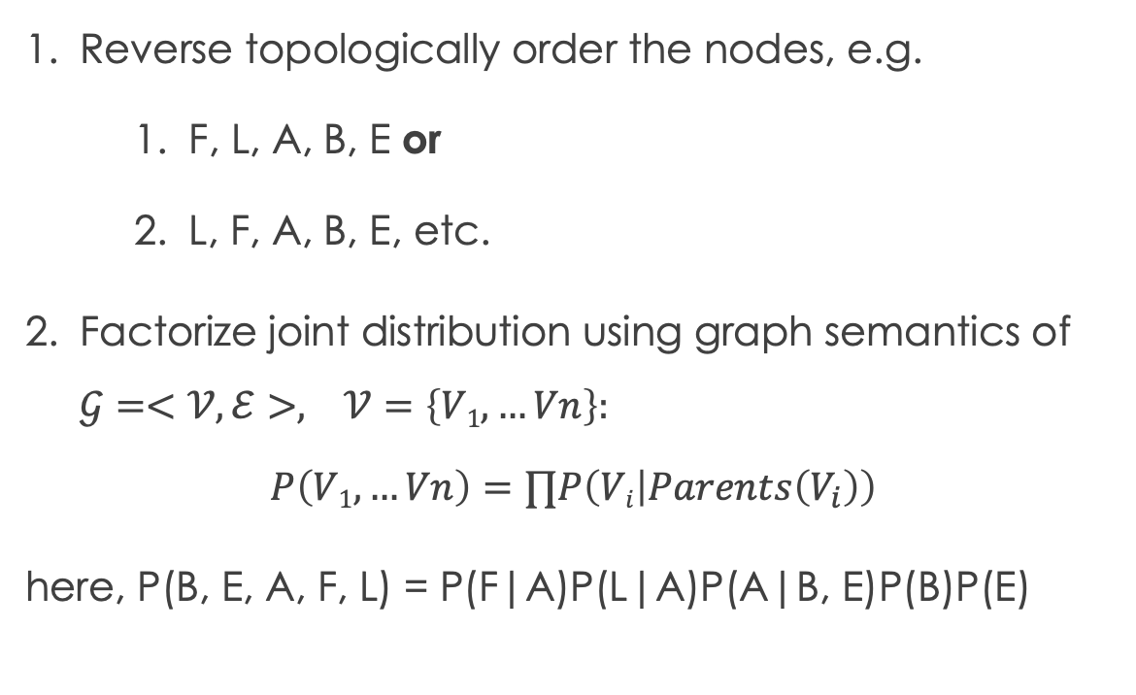
Recap: Bayes Nets as factorization
Reverse topologically order the nodes, e.g.
F, L, A, B, E or
L, F, A, B, E, etc.
Factorize joint distribution using graph semantics of $𝒢=<𝒱,ℰ>, 𝒱=\left\{V1,…Vn\right\}:$
$$P\left(V1,…Vn\right)=∏P\left(Vi | Parents\left(V_{i}\right)\right)$$
here, P(B, E, A, F, L) = P(F|A)P(L|A)P(A|B, E)P(B)P(E)
B
E
A
F
L

Slide 4
Recap: d-separation
Classical definition (Pearl):
A set Z is said to d-separate X from Y iff Z blocks every path from a node in X to a node in Y.
A path p is blocked by Z iff:
p contains a chain i -> m -> j or a fork I <- m -> j such that m is in Z, or
p contains a collider i -> m <- j such that m is NOT in Z and no descendant of m is in Z.
B
E
A
F
L
Independence gives us useful, fast queries.

Slide 5
Recap: Partial Observability
We may need to reason about latent or unobserved nodes.
Because they are unmeasured, we cannot reason about their specific values.
Depending on the task, we either:
Marginalize over them (inference).
Compute their expected values (decision making).
B
E
A
F
L
Both are forms of integration!

Slide 6
Bayes Nets beyond factorizations
Scenario: 3 variable, no independence relations
Example: height (H), weight (W), success (S)
Possible factorizations of P(H, W, S):
P(S | H, W)P(H| W)P(W) P(S | H, W)P(W | H)P(H)
P(H | S, W)P(S | W)P(W) P(H | S, W)P(W | S)P(S)
P(W | H, S)P(H | S)P(S) P(W | H, S)P(S | H)P(H)
All are equivalent factorizations (i.e., same probability distribution)
Notes:
1. Search for pairwise independence for root nodes

Slide 7
Bayes Nets beyond factorizations
H
Scenario: 3 variable, no independence relations
Example: height (H), weight (W), success (S)
Possible factorizations of P(H, W, S):
P(S | H, W)P(H| W)P(W) P(S | H, W)P(W | H)P(H)
P(H | S, W)P(S | W)P(W) P(H | S, W)P(W | S)P(S)
P(W | H, S)P(H | S)P(S) P(W | H, S)P(S | H)P(H)
W
S
Qualitative differences
Notes:
1. Search for pairwise independence for root nodes

Slide 8
Bayes Nets beyond factorizations
S
Scenario: 3 variable, no independence relations
Example: height (H), weight (W), success (S)
Possible factorizations of P(H, W, S):
P(S | H, W)P(H| W)P(W) P(S | H, W)P(W | H)P(H)
P(H | S, W)P(S | W)P(W) P(H | S, W)P(W | S)P(S)
P(W | H, S)P(H | S)P(S) P(W | H, S)P(S | H)P(H)
W
H
Qualitative differences
Notes:
1. Search for pairwise independence for root nodes

Slide 9
Causal relations
X causes Y iff:
X happens before Y
Manipulating X leads to a change in Y (probabilistically)
Used informal background knowledge about temporal precedence and causality to encode independence
Earthquakes and burglaries both cause the alarm to trigger.
Earthquakes don’t cause burglaries, nor earthquakes
Fry and Leela never

